Slide 1
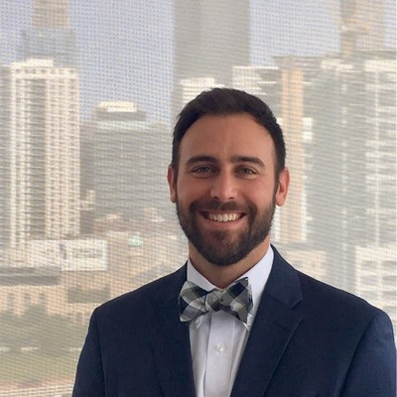

Andrew Delaney Experiences
INDUSTRIES
Industry Experience
Technology | Software as a Service | Healthcare | Education | Video Conferencing | Human Resources
EXPERIENCE
Scoot | Software as a Service, Video Conferencing
Managed complete product development lifecycle for video communications application from ideation to launch, resulting in monthly active user growth 11x over 18 months and acquiring multiple Fortune 100 customers
Developed and executed product strategy and roadmaps for 3 engineering teams across mobile and desktop applications
Collaborated with cross functional teams including engineering, design, marketing, and customer support to deliver high quality products using agile methodology
Communicated with C-suite executives and department heads to ensure alignment on product vision
Worked closely with customers and customer success teams to understand user pain points, translating feedback into actionable product requirements
Hired and managed multiple employees across the Product, Engineering, and Customer Success organizations
Defined key performance metrics and utilized deep technical skills using SQL queries and analytics tools to analyze data and identify trends around product usage
Executed multiple technical initiatives such as: developed public rest APIs using FastAPI framework along with accompanying CI/CD pipeline, designed architecture for complex WebRTC scalability infrastructure, guided engineers in WebRTC training, and built enterprise grade reporting using AWS Quicksight
BACKGROUND
Functional Skills
Product Leadership, Engineering Leadership, Business Processes, Product Strategy, UI/UX, Agile Methodology, Product Roadmaps, AI/ML, Full Stack Development
Qualifications:
Led Product and Engineering organizations in design and build of an enterprise grade global video communications platform, resulting in a $12M Series A. This product served multiple Fortune 100 companies with a highly innovative video conferencing solution.
BIO & CONTACT INFO
Email
andrew.delaney@thebridge.com
Mobile
(704) 517-6513
Location
DFW, Texas
Andrew joined The Bridge in February 2024. He has 15 years of experience in technology start ups and management consulting. A relentless learner, Andrew excels at quickly consuming information and leveraging this skill to resolve complex business problems.

